Slide 1
Nanoservice-enabled event-driven decision support
REST API
Demo
(Hyponatremia)
For more information about Nanoservice, please visit https://csml.uconn.edu/

Slide 2
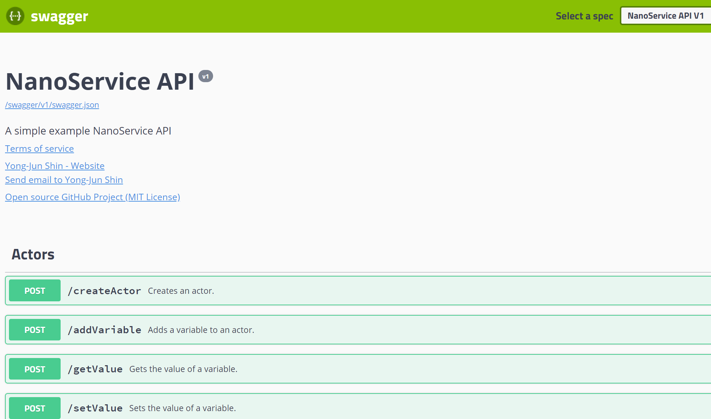
Step 1: Go to http://csmlab7.uconn.edu/swagger/

Slide 3

Step 2 [createActor]: Click

Slide 4
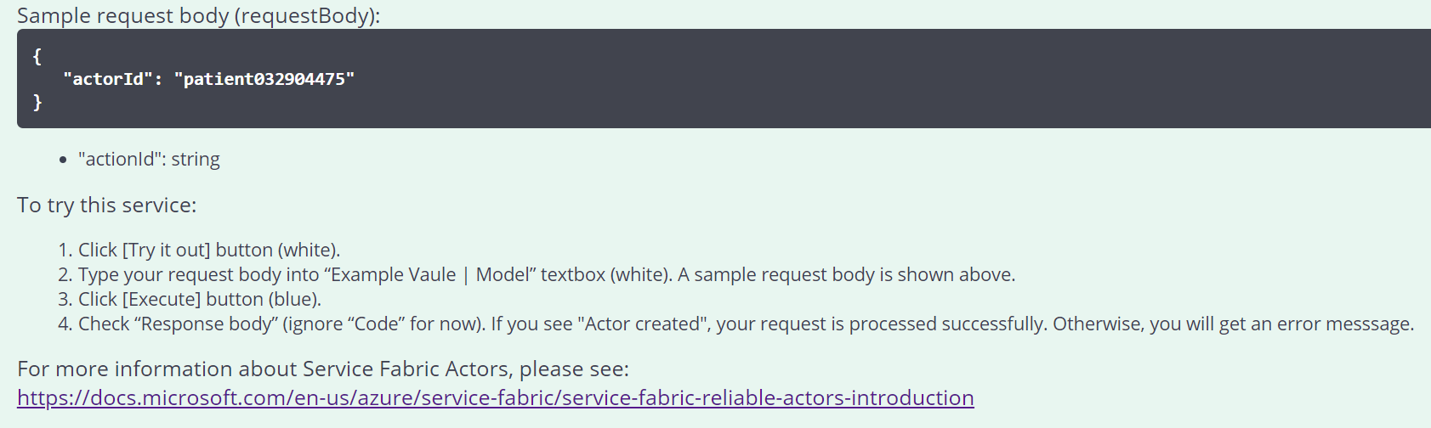
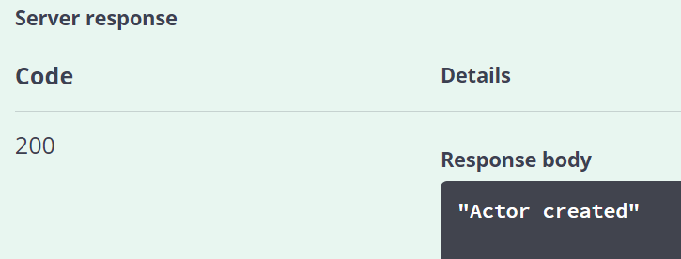
Step 3 [createActor]: Follow the instruction and create a patient (actor) with a unique ID (actorId).
Service Fabric Actors https://docs.microsoft.com/en-us/azure/service-fabric/service-fabric-reliable-actors-introduction

Slide 5
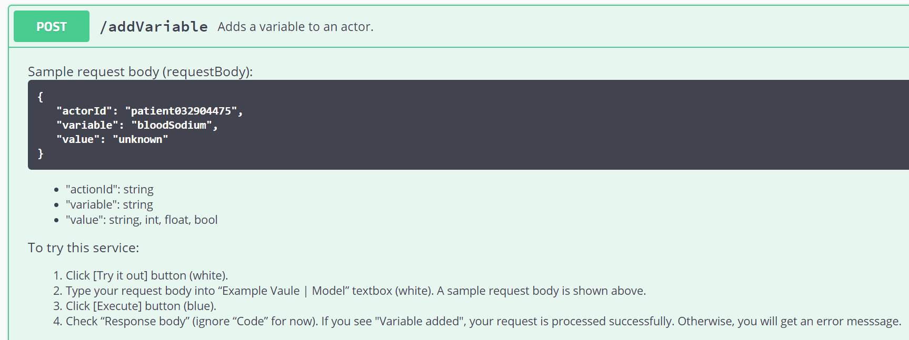
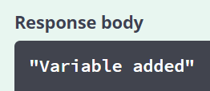
Step 4 [addVariable]: Add a variable (“bloodSodium”) to the previously created patient actor. Let the variable value be “unknown” initially

Slide 6
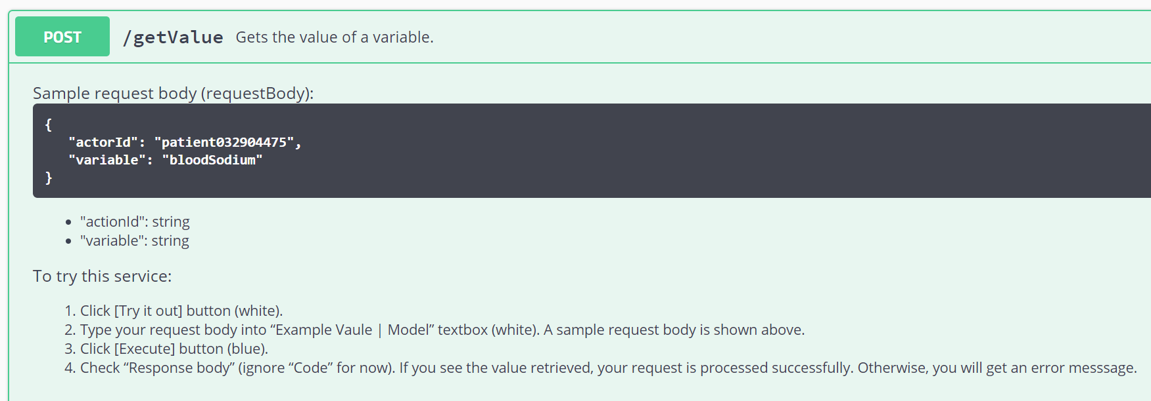
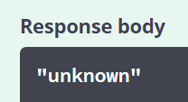
Step 5 [getValue]: Get the value of the variable “bloodSodium” which is “unknown”.

Slide 7
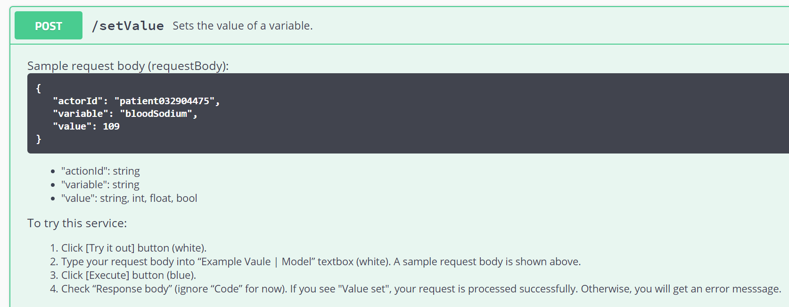
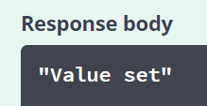
Step 6 [setValue]: Set the value of the variable “bloodSodium” to 109. The unit is mEq/L and not included.
Note this new value is also published to Azure Event Grid.

Slide 8
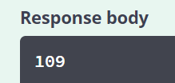
Step 7 [getValue]: Get the value of the variable “bloodSodium” which is now changed to 109.

Slide 9
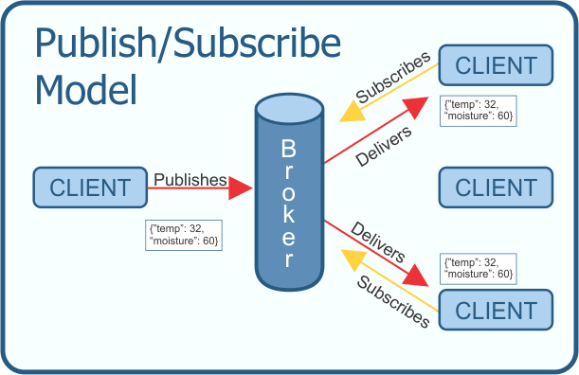
Azure Function
(HyponatremiaDDx)
Service Fabric Actor
(Patient Actor)
Azure Event Grid
https://dev.to/kenwalger/overview-of-the-mqtt-protocol

Slide 10
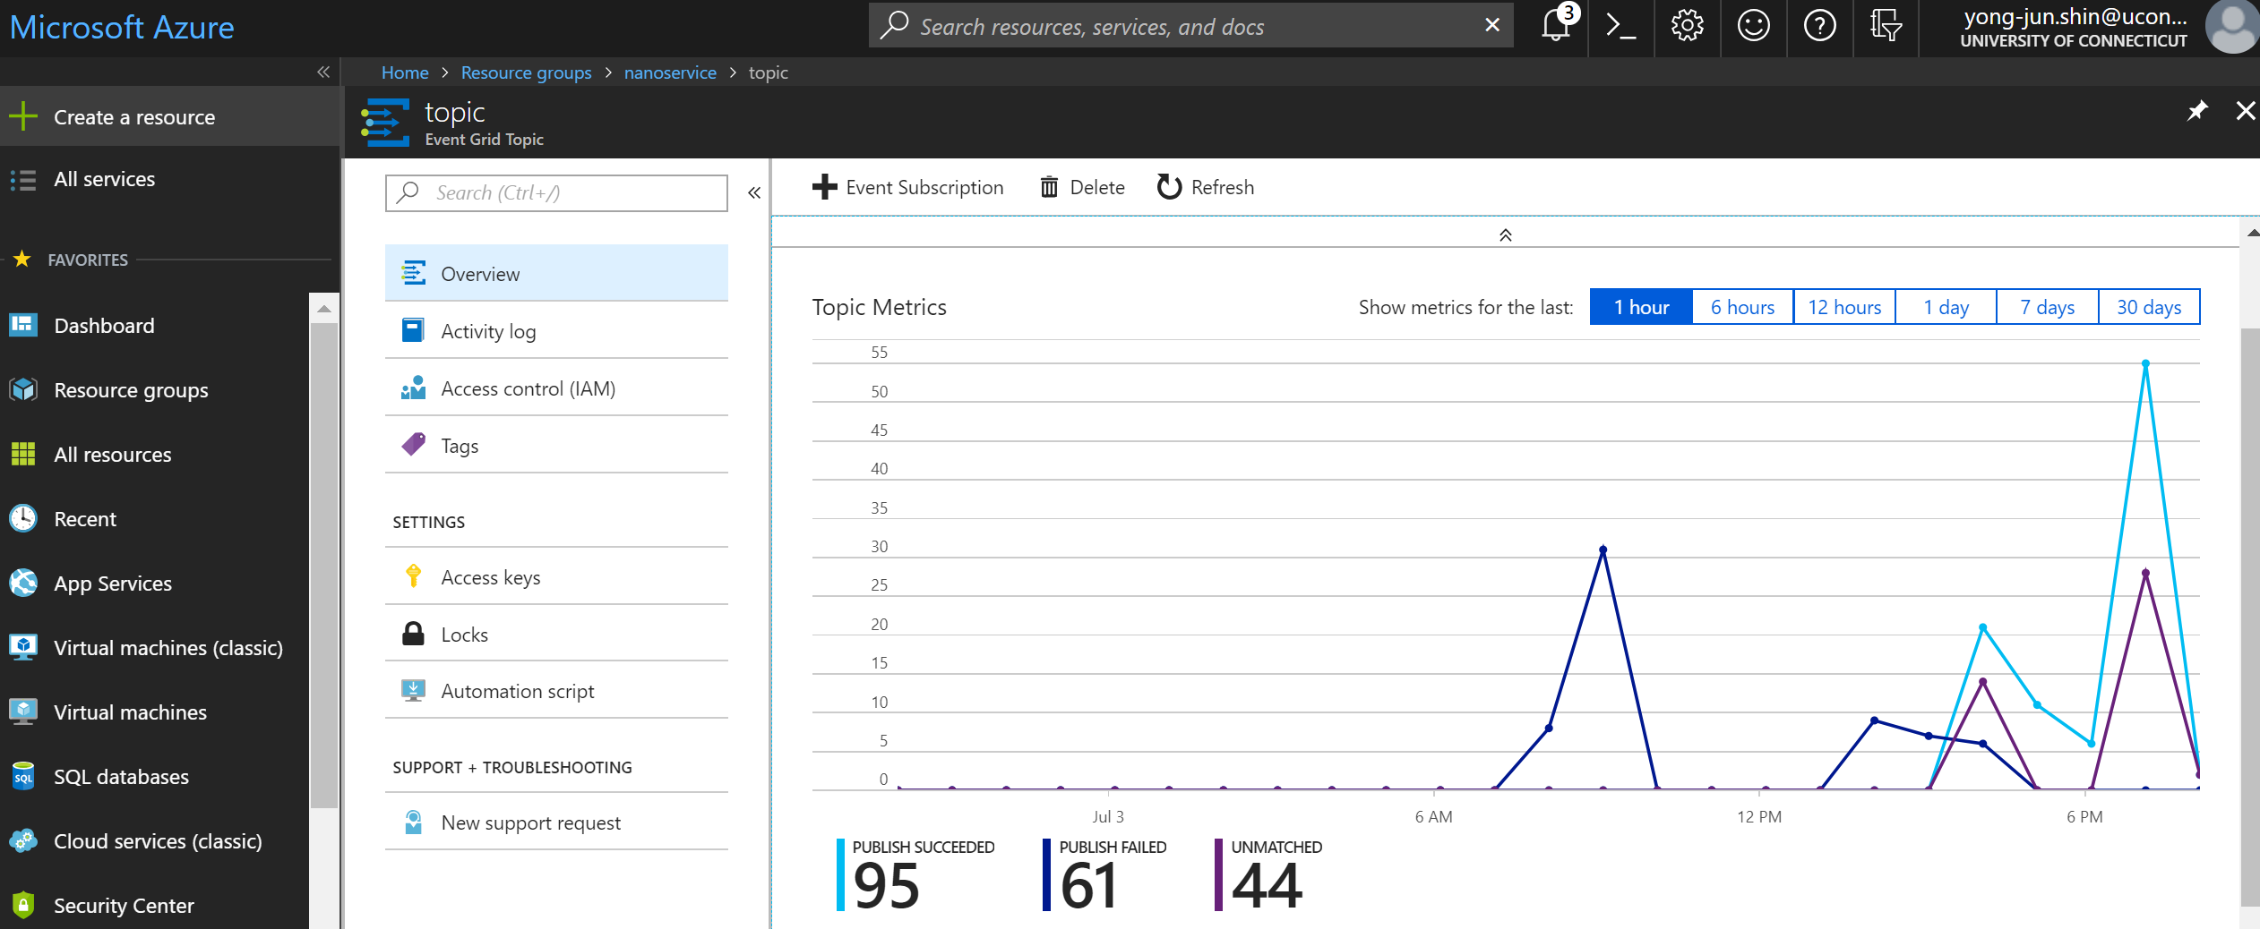
Azure Event Grid https://azure.microsoft.com/en-us/services/event-grid/

Slide 11
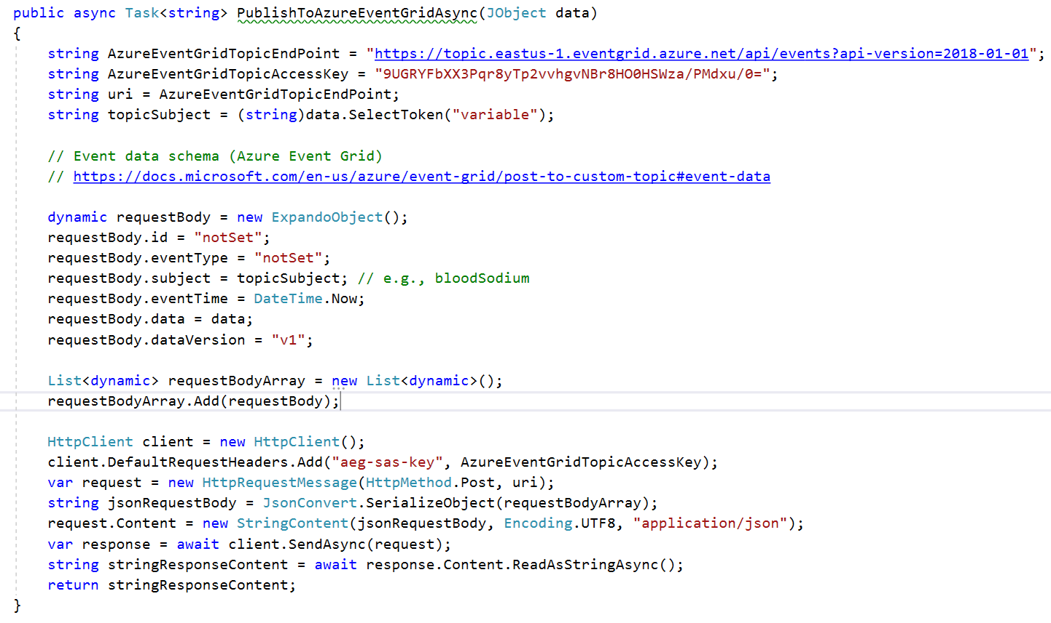
Code for publishing an event to Azure Event Grid
Source code available at https://github.com/yshin1209/Nanoservice

Slide 12
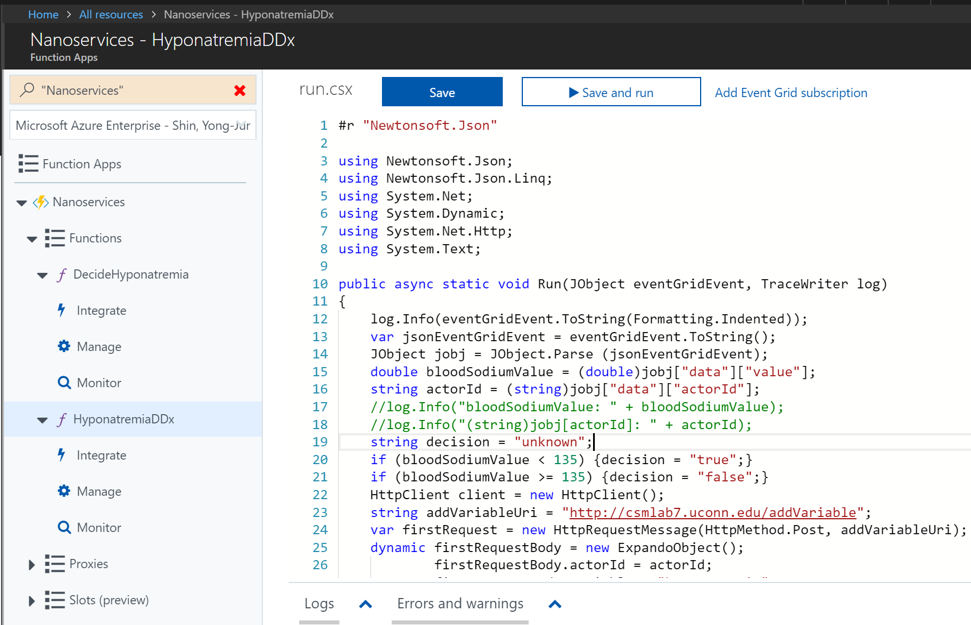
Azure Function https://azure.microsoft.com/en-us/services/functions/
This Azure Function (HyponatremiaDDx) subscribes to Azure Event Grid and is triggered whenever a new bloodSodium value is published (new event).

Slide 13

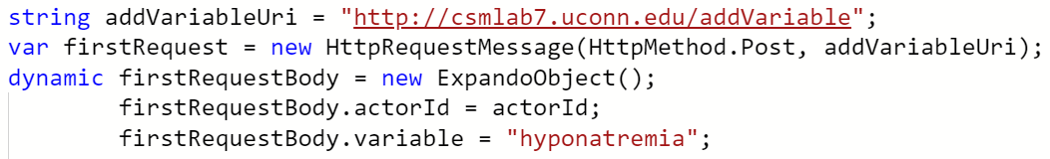
Azure Function https://azure.microsoft.com/en-us/services/functions/
The HyponatremiaDDx function 1) decides whether it is hyponatremia or not, 2) adds a new variable “hyponatremia” to the patient actor in case the variable is not yet added, and 3) sets the value to true (hyponatremia) or false (not hyponatremia).

Slide 14
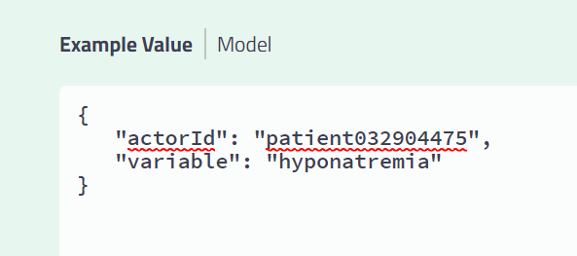
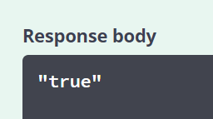
Step 8 [getValue]: Get the value of the variable “hyponatremia” which is now “true” (because 109 < 135)

Slide 15
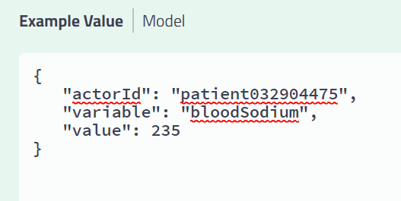
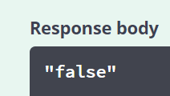
Step 9 [setValue]: Set the value of the variable “bloodSodium” to 235.
Step 10 [getValue]: Get the value of the variable “hyponatremia” which is now “false” (because 235 > 135)

Slide 16
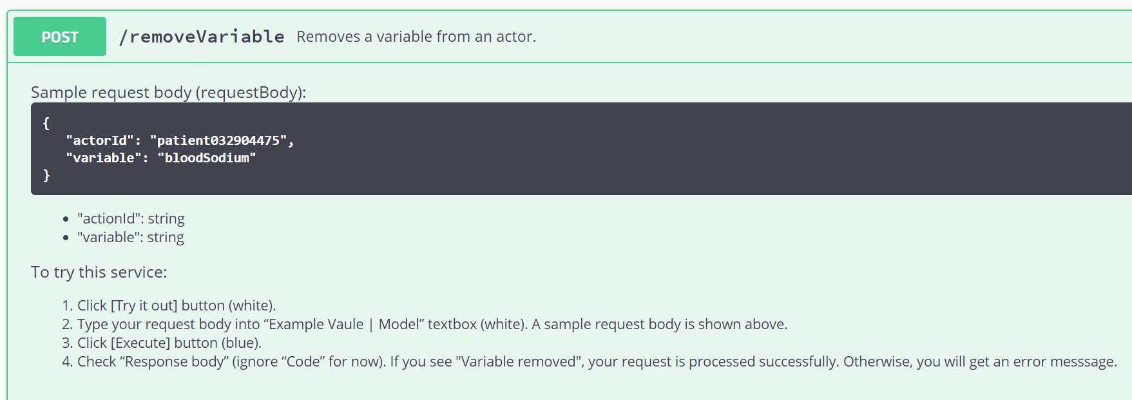
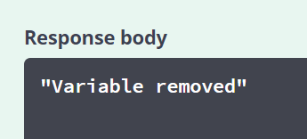
Step 11 [removeVariable]: Remove the variable “bloodSodium”.
For more information about Nanoservice, please visit https://csml.uconn.edu/

